Slide 1
Exception
Yubin Xia
IPADS, SJTU
ACKs: Some slides are adapted from the textbook's original slides and Frans's OS course notes

Slide 2
Review: IPC
Cooperating processes need inter-process communication (IPC)
Two models of IPC
Shared memory
Message passing
In POSIX
Pipe, message passing, signal, shared memory, semaphore, etc.
LRPC: Lightweight RPC

Slide 3
Concepts
Exception
refers to an illegal program action
Interrupt
refers to a signal generated by a hardware device
System call
a user program can ask for an operating system service

Slide 4
Exception

Slide 5
CPU's 'fetch-execute' cycle
User
Program
Fetch instruction at IP
ld
add
st
mul
ld
sub
bne
add
jmp
…
Decode the fetched instruction
Save context
IP
Execute the decoded instruction
Get INTR ID
Lookup ISR
Advance IP to next instruction
Execute ISR
Interrupt?
yes
IRET
no

Slide 6
Exception Table
Exception
numbers
code for
exception handler 0
1. Each type of event has a unique exception number k
2. Exception table entry k points to a function (exception handler).
3. Handler k is called each time exception k occurs.
Exception
table
code for
exception handler 1
0
1
code for
exception handler 2
2
...
n-1
...
code for
exception handler n-1

Slide 7
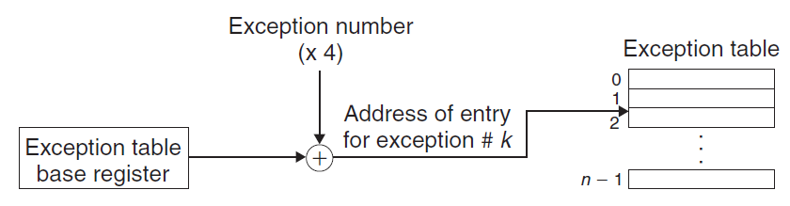
Exception Table

Slide 8
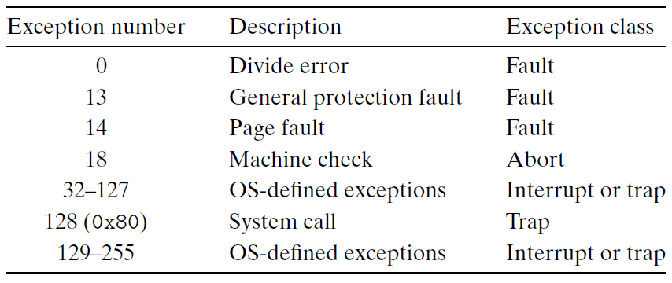
Some Exception on Intel CPU
Notes:
Questions:
What is the difference between an exception and an interrupt caused by hardware?
Can system call be implemented by using int 0x81 or 0x82?

Slide 9
IDT (or Trap Vector in xv6)
IDT: interrupt descriptor table
Another name of exception table
Has 256 entries
Each giving the %cs and %eip to be used when handling the corresponding interrupt
System call
A program invokes int n
int is for interrupt (not integer)
n specifies the index into the IDT

Slide 10
Exception Handler
The processor pushes a return address on the stack, the return address is:
either the current instruction (e.g., page fault)
or the next instruction (e.g., hardware interrupt)
The processor also pushes some additional processor state onto the stack
Will be necessary to restart the interrupted program when the handler returns
e.g. the current condition codes

Slide 11
Exception Handler
All items are pushed onto the kernel stack
Rather than onto the user's stack
If control is being transferred from a user program to the kernel
Exception handlers run in kernel mode
Means they have complete access to all system resources

Slide 12
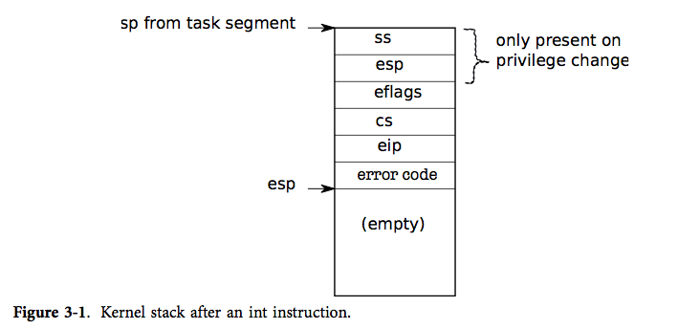
Kernel Stack

Slide 13
Stack Change
Question: why not use user's stack?

Slide 14
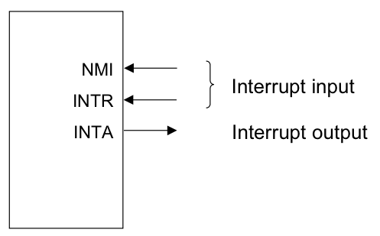
Sources of Events cause User->Kernel
Device interrupt: external
Nonmaskable interrupt (NMI) input pin
Interrupt (INTR) input pin
Software interrupt: execution of the Interrupt instruction
E.g., INT
Program faults: If some error condition occur by the execution of an instruction.
E.g.,divide-by-zero interrupt

Slide 15
What Has to Happen?
Must save the processor's registers for future transparent resume
Must be set up for execution in the kernel
Must chose a place for the kernel to start executing
Must be able to retrieve information about the event, e.g., system call arguments
Must all be done securely
Must maintain isolation of user processes and the kernel

Slide 16
Return From Interrupt Handler in Kernel
The 'iret' instruction
Restore the process's context
Switch from kernel mode to user mode
Continue the execution of user's process

Slide 17
Simplified: Call OS Services from Apps and Devices
Exception
Application (CPU)
Exception
Table
OS
Services
I/O Device
Interrupt
Notes:
Question: what if

Slide 18
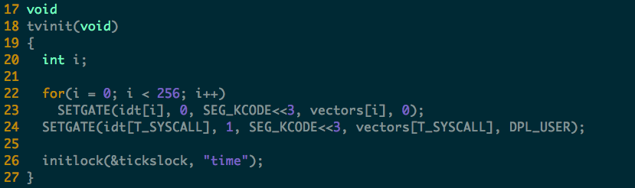
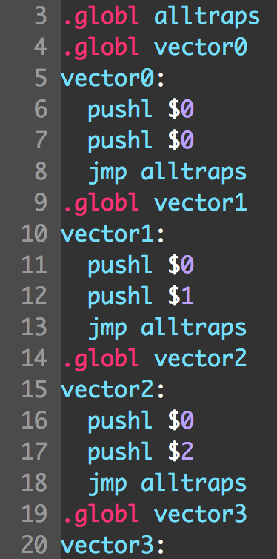
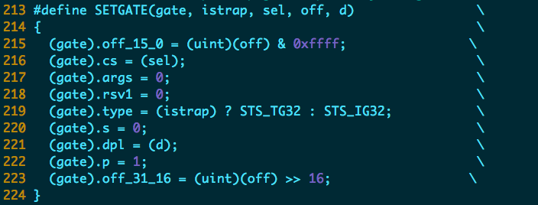
xv6: Initialize the Exception Table

Slide 19
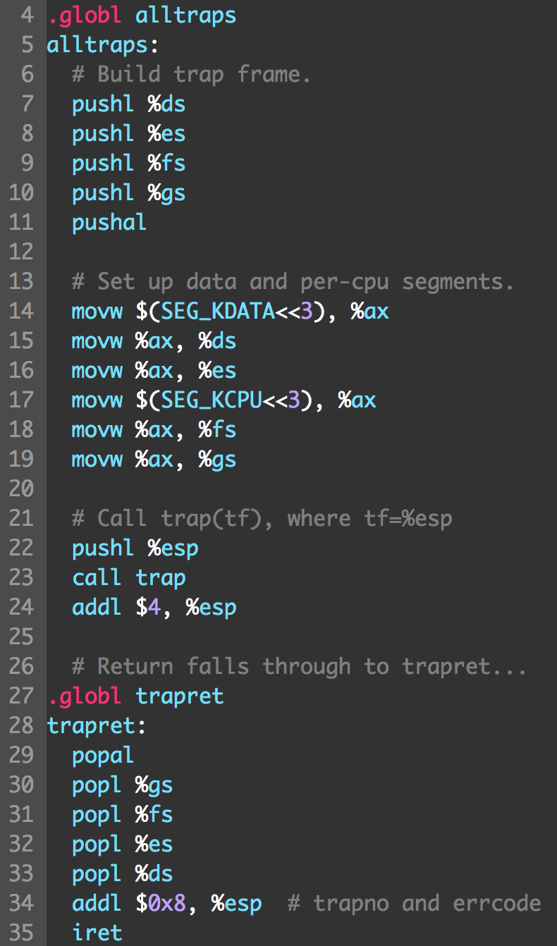
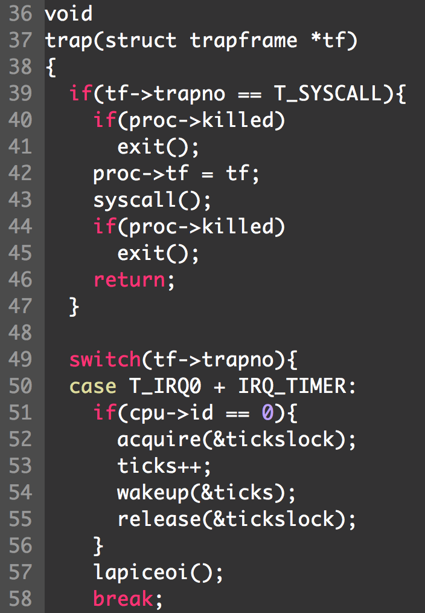
xv6: Trap

Slide 20
Three Crucial Data-structures
The Global Descriptor Table (GDT)
defines the system's memory-segments and their access-privileges, which the CPU has the duty to enforce
The Interrupt Descriptor Table (IDT)
defines entry-points for the various code-routines that will handle all 'interrupts' and 'exceptions‘
The Task-State Segment (TSS)
holds the values for registers SS and ESP that will get loaded by the CPU upon entering kernel-mode

Slide 21
How does CPU find GDT/IDT?
Two dedicated registers: GDTR and IDTR
Both have identical 48-bit formats:
Segment Base Address
Segment Limit
47
16
15
0
Kernel must setup these registers during system startup (set-and-forget)
Privileged instructions: LGDT and LIDT used to set these register-values
Unprivileged instructions: SGDT and SIDT used for reading register-values

Slide 22
How does CPU find the TSS?
Dedicated system segment-register TR holds a descriptor's offset into the GDT
The kernel must set up the
GDT and TSS structures
and must load the GDTR
and the TR registers
GDT
TSS
TR
The CPU knows the layout
of fields in the Task-State
Segment
GDTR

Slide 23
Interrupt

Slide 24
Varying Terminology for Intel
Interrupts (asynchronous, device generated)
Maskable: device-generated, associated with IRQs (interrupt request lines); may be temporarily disabled (still pending)
Nonmaskable: some critical hardware failures
Exceptions (synchronous, from software)
Processor-detected
Faults – correctable (restartable); e.g. page fault
Traps – no reexecution needed; e.g. breakpoint
Aborts – severe error; process usually terminated (by signal)
Programmed exceptions (software interrupts)
int (system call), int3 (breakpoint)
into (overflow), bounds (address check)

Slide 25
Terms
Vector, Interrupt vector, Trap number
IRQ: Interrupt Request
Note: Soft IRQ is a mechanism to implement bottom half, it has nothing to do with IRQ!
Interrupt, trap, fault, exception
Software interrupt / system call
IDT: Interrupt Descriptor Table
ISP: Interrupt Service Procedure

Slide 26
Intel-Reserved ID-Numbers
Of the 256 possible interrupt ID numbers, Intel reserves the first 32 for 'exceptions'
OS's such as Linux are free to use the remaining 224 available interrupt ID numbers for their own purposes (e.g., for service-requests from external devices, or for other purposes such as system-calls)
Examples:
0: divide-overflow fault
6: Undefined Opcode
7: Coprocessor Not Available
11: Segment-Not-Present fault
12: Stack fault
13: General Protection Exception
14: Page-Fault Exception

Slide 27
Interrupts
Interrupts are similar to system calls, except devices generate them at any time
There is hardware on the motherboard to signal the CPU when a device needs attention (e.g., the user has typed a character on the keyboard)
We must program the device to generate an interrupt, and arrange that a CPU receives the interrupt

Slide 28
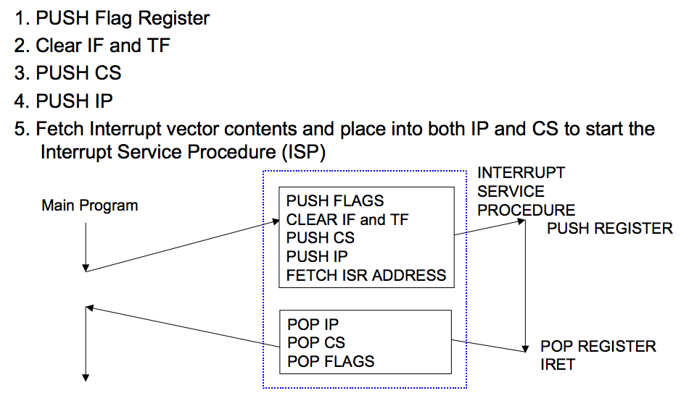
Interrupt Response Sequence

Slide 29
Early Boards
PIC (Programmable Interrupt Controller)
picirq.c
8259A chip
Each PIC handles 8 interrupts, and multiplex them on the interrupt pin of the processor
PIC can be cascaded
Master: 0 to 7
Slave: 8 to 15
Read timer.c for timer init

Slide 30
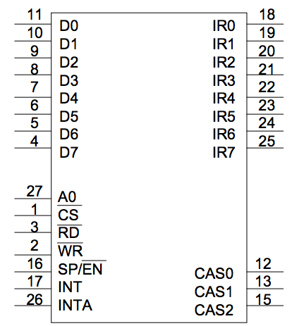
8259A Programmable Interrupt Controller (PIC)
8259A is a 28-pin integrated circuit which was designed specifically for the 8088/8086 microprocessors
Notes:
❚ The 28 pins of the 8259A include:
1. Data pins D0-D7 - connected to the data bus to allow programming
2. IR0-IR7 - 8 interrupt inputs
3. CAS0-CAS2 - cascade lines (used in multiple 8259A systems)
4. SP/EN - functions as data buffer enable output (when buffered mode)
or as an input to program the 8259A as a master or slave
5. A0 - input which selects different command words in the 8259A
❚ Usually IR0 has the highest priority and IR7 the least priority.
❚ Fully nested interrupts are supported (higher priority interrupts may
interrupt the interrupt service routine of a lower priority interrupt) if bit 4 of
ICW is set. (Refer to data sheets for further details.)

Slide 31
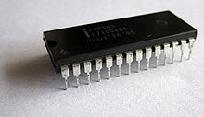
Interrupt Hardware
Legacy PC Design
(for single-proc
systems)
IRQs
Slave
PIC
(8259)
Master
PIC
(8259)
x86
CPU
Ethernet
INTR
SCSI Disk
Real-Time Clock
Keyboard Controller
Programmable Interval-Timer
I/O devices have (unique or shared) Interrupt Request Lines (IRQs)
IRQs are mapped by special hardware to interrupt vectors, and passed to the CPU
This hardware is called a Programmable Interrupt Controller (PIC)

Slide 32
APIC, IO-APIC, LAPIC
Advanced PIC (APIC) for SMP systems
Used in all modern systems
Interrupts “routed” to CPU over system bus
IPI: inter-processor interrupt
Local APIC (LAPIC) versus “frontend” IO-APIC
Devices connect to front-end IO-APIC
IO-APIC communicates (over bus) with Local APIC
Interrupt routing (like on a network)
Allows broadcast or selective routing of interrupts
Ability to distribute interrupt handling load
Routes to lowest priority process
Special register: Task Priority Register (TPR), i.e., locking
Arbitrates (round-robin) if equal priority

Slide 33
Multiple Processors
Multi-CORE CPU
CPU
0
CPU
1
I/O
APIC
LOCAL
APIC
LOCAL
APIC
Advanced Programmable Interrupt Controller is needed to
perform 'routing' of I/O requests from peripherals to CPUs
(The legacy PICs are masked when the APICs are enabled)
Notes:
External hardware INTerrupt sources are routed to pins of the IO APIC. These include motherboard sources such as the 8254 timer, as well asISA/PCI card slots. INTerrupts are "collected" by this part, and forwarded via the APIC bus to one or more CPUs when they occur.

Slide 34
Multi-processor PC Boards
Two parts in XV6
IO APIC, for the I/O system
ioapic.c
Local APIC, for each processor
lapic.c
XV6 is designed for multi-processor
Each processor must be programmed to receive interrupts

Slide 35
Assigning IRQs to Devices
IRQ assignment is hardware-dependent
Sometimes it's hardwired, sometimes it's set physically, sometimes it's programmable
PCI bus usually assigns IRQs at boot
Some IRQs are fixed by the architecture
IRQ0: Interval timer
IRQ2: Cascade pin for 8259A
Linux device drivers request IRQs when the device is opened
Note: especially useful for dynamically-loaded drivers, such as for USB or PCMCIA devices
Two devices that aren't used at the same time can share an IRQ, even if the hardware doesn't support simultaneous sharing

Slide 36
Some Details on IRQ
Some hardware IRQs are pre-determined
E.g., the system timer (IRQ0), Keyboard controller (IRQ1), floppy controller (IRQ6), real-time clock (IRQ8) and Math Co-processor (IRQ13)
Most others are 'user' determined
via hardware (with jumpers)
via software (such as installable drivers) with firmware (PNP)
IRQs that are usually available for add-on devices:
Modem (IRQ5), printer (IRQ7), Sound Card (IRQ9/IRQ10)
Video Card (IRQ11) and PS/2 mouse (IRQ12)
IRQ3 and IRQ4 are usually reserved for serial ports
IRQ14 and IRQ15 are used for the IDE (primary and secondary)

Slide 37
Assigning Vectors to IRQs
Vector: index (0-255) into interrupt descriptor table
Vectors are usually IRQ# + 32
Below 32 reserved for non-maskable intr & exceptions
Maskable interrupts can be assigned as needed
Vector 128 used for syscall
Vectors 251-255 used for IPI

